Slide 1
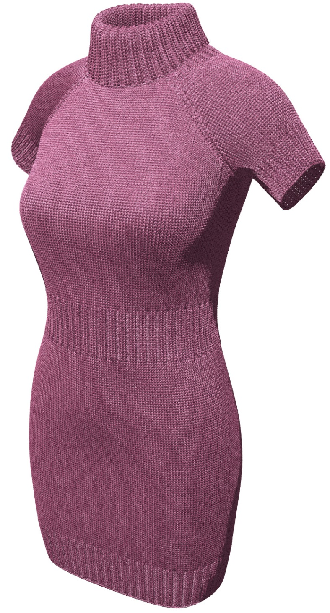
Real-time Fiber-level Cloth Rendering
Kui Wu & Cem Yuksel
University of Utah
Notes:
Hi Everyone, my name is Kui WU. Today, I am going to present our work about real-time fiber-level cloth rendering

Slide 2
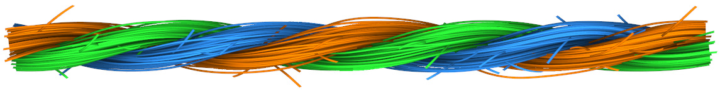
Cloth Structure
Ply 1
Ply 2
Ply 3
Yarn
Ply
Fibers
Notes:
Cloth is made up of yarn pieces interlocked each other. So, let’s begin with yarn structure.
[click]
yarn consist of multiple plies.
[click]
Tens to hundreds of fibers twist to form ply. The complex geometry and irregular surface determine it is not easy to render.

Slide 3



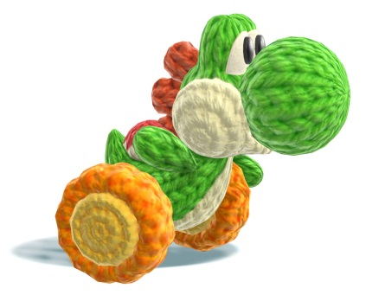
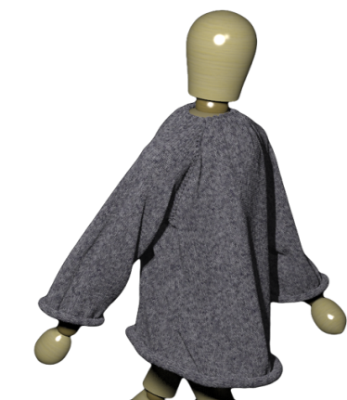
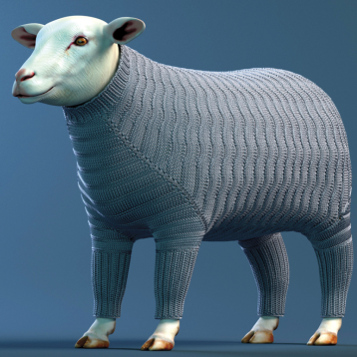
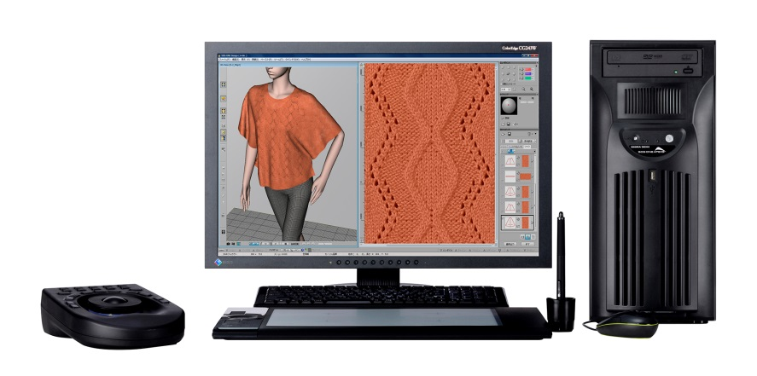
Yarn Rendering
Animation
Game
Monster University
Inside Out
Little Big Planet
Yoshi’s Wooly World
Model &
Simulation
Fabrication design
[Kaldor et al. 2010]
[Yuksel et al. 2012]
Shima Seiki
Notes:
[click]
Knitted materials are used in animation and [click] game to make some interesting effects.
[click]
Rendering the knitted material is important for Yarn-level modeling and simulation.
[click]
Fabrication also requires rendering yarn at real-time to get fast feedback.

Slide 4
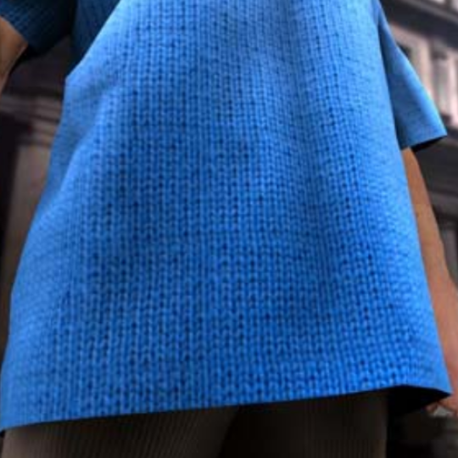
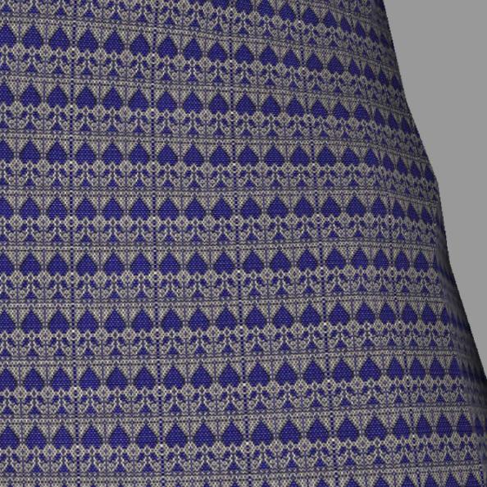
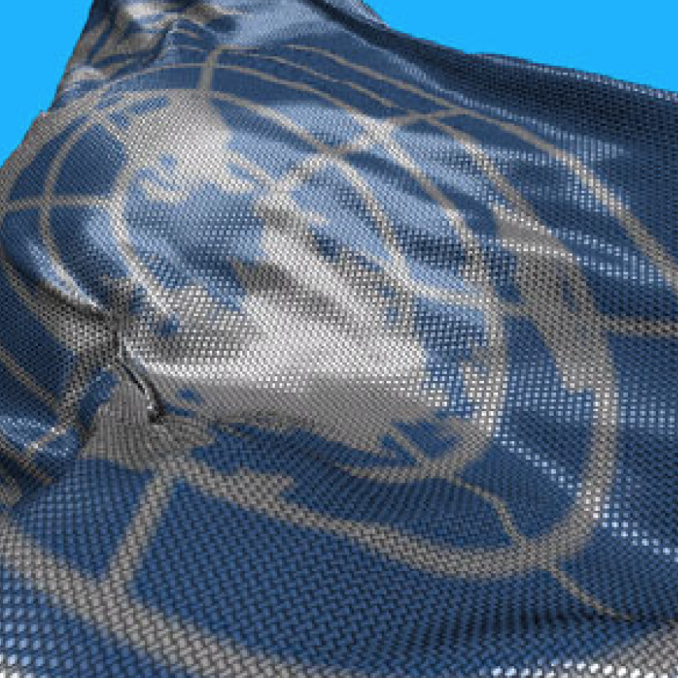
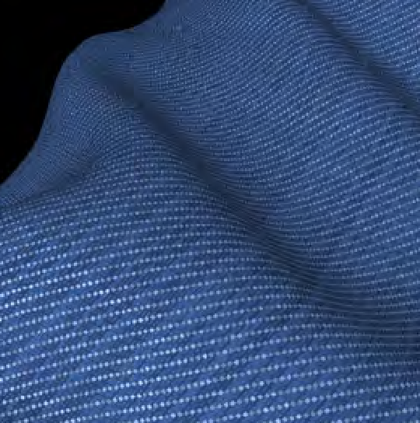
Prior Works
Surface-based Approaches
[Meseth et al. 2003]
[Adabala et al. 2003]
[Kang et al. 2010]
[Yuen et al. 2012]
Real-time
Lack of considering knit structure deformation
No fuzzy appearance
Notes:
The previous surface-based approaches use texture or specialized brdf to get fabric appearance. They can render cloth in real-time, but they all suffer the drawbacks like incorrect diffusion of light, lack of considering knitting structure deformation, and no fuzzy appearance.

Slide 5
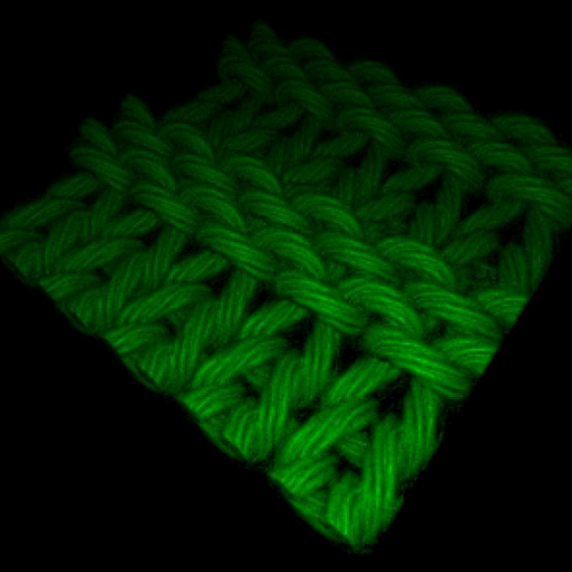
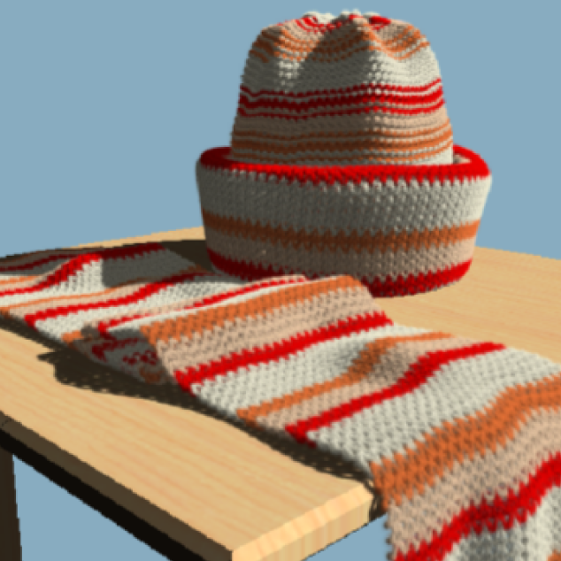
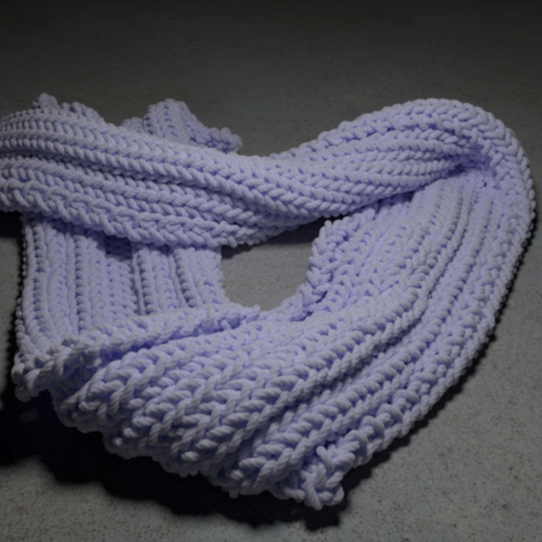
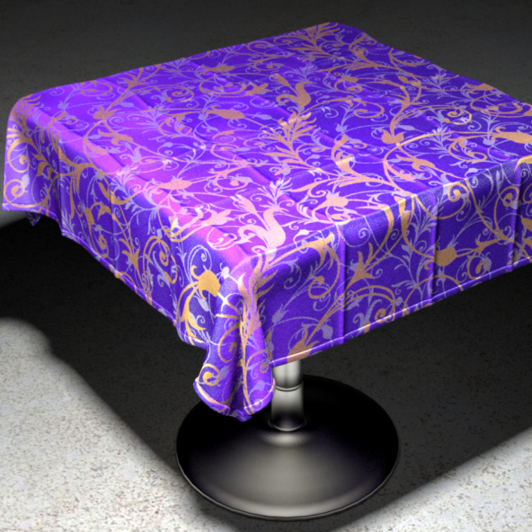
Prior Works
Volumetric Approaches
[Groller et al. 1995]
[Xu et al. 2001]
[Jakob et al. 2010]
[Zhao et al. 2013]
Realistic
Hours of rendering time
Gigantic data
Notes:
Another way is volumetric approaches which convert fiber geometry to volumetric data. They can produce realistic result, but require gigantic volume data and hours of rendering time. So, it is not suitable for real-time application like game and fabric design.

Slide 6
Real-time Fiber-level Cloth Rendering
Real-time
Fiber-level details
Notes:
Therefore, we propose our real-time fiber-level cloth rendering method, which can produce fiber-level details and work in the real-time.

Slide 7
Real-time Fiber-level Cloth Rendering
Real-time
Fiber-level details

Slide 8
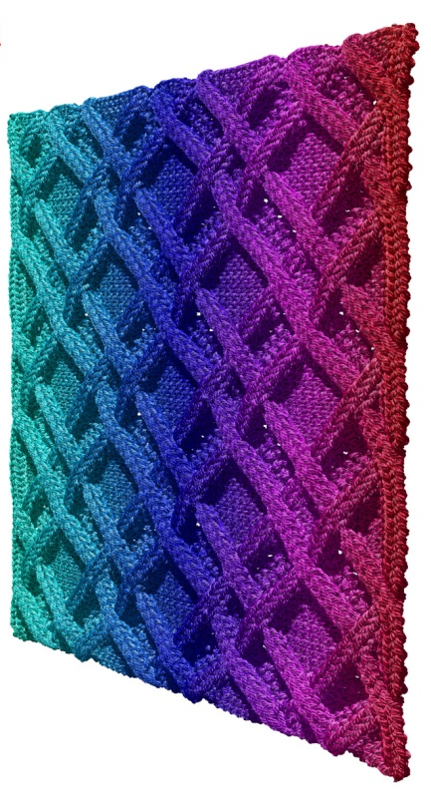
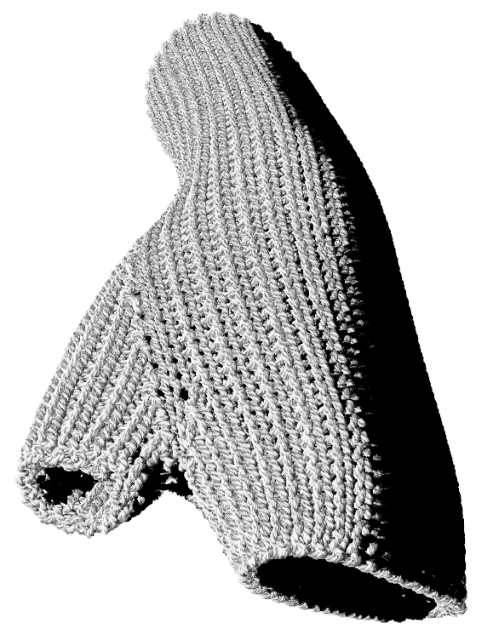
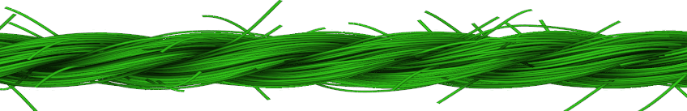
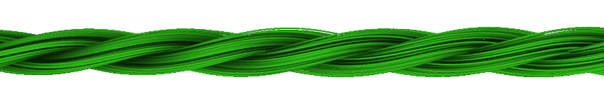
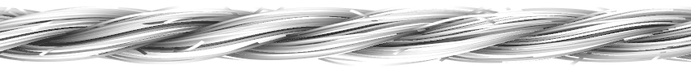
Overview
Modified Procedural
Yarn Model
Core Fibers
LoD
Self-shadows
Ambient Occlusion

Slide 9
Overview
Modified Procedural
Yarn Model
Core Fibers
LoD
Self-shadows
Ambient Occlusion

Slide 10
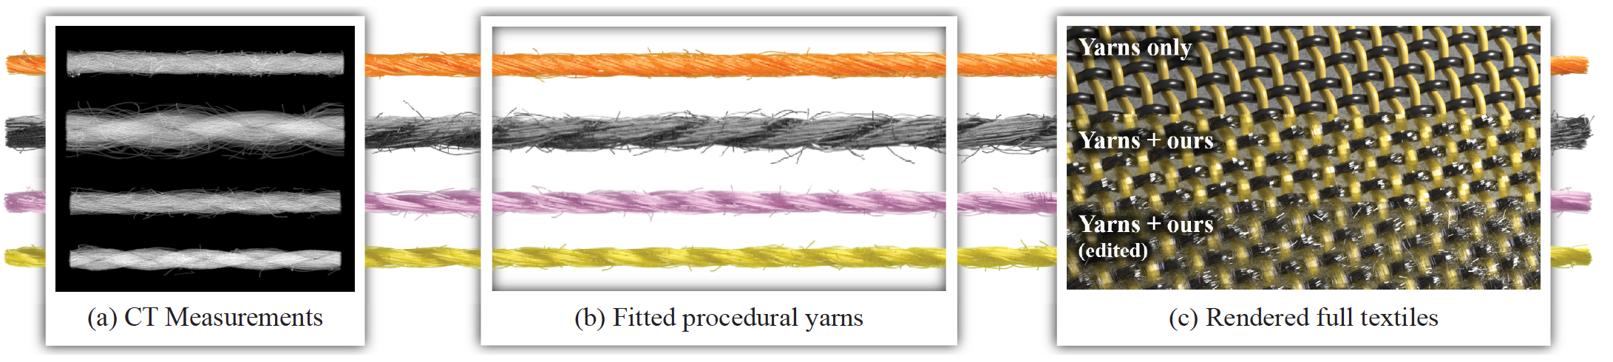
Procedural Yarn Model
Introduced by [Zhao et al. 2016]
Fitting with real CT data
Procedural method with 22 parameters
[Zhao et al. 2016]
Notes:
Our work is based on use a procedural yarn model introduced by Zhao and his colleague last year. The model fit with real CT data and require 22 parameters. User can create their own yarn model by changing the parameters.

Slide 11
Input Data
Input: yarn curve control points
Fibers are generated on the fly
Notes:
To minimized the data transitting between cpu to gpu, our method only send yarn curve control points to gpu and all fibers will be generated on the ply based on the procedural model.

Slide 12
Fiber Generation
yarn boundary
yarn
c
Notes:
Given a simple example. All red nodes are yarn control points. For any cross-section of yarn, we do a two stages displacement. [click]

Slide 13
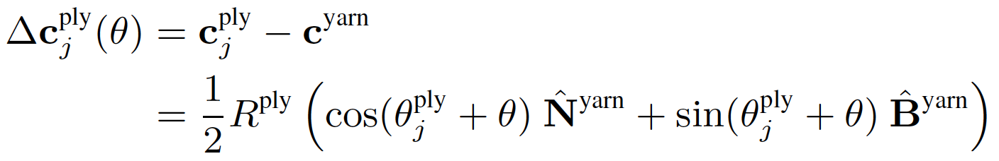
Fiber Generation
ply boundary
yarn boundary
ply
c
j
yarn
ˆ
N
ˆ
B
yarn
yarn
c
Notes:
We first displace the ply center from yarn center based on the polar angle and yarn normal direction

Slide 14
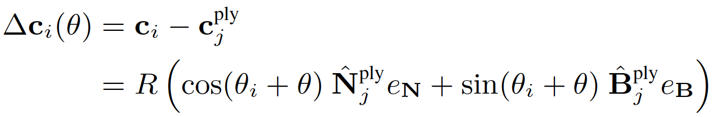
Fiber Generation
ˆ
ply
ply boundary
N
j
yarn boundary
c
i
ply
c
j
yarn
ˆ
N
ˆ
B
ply
j
ˆ
B
yarn
yarn
c
Notes:
We can do the same thing to get the fiber center as well. Note that yarn cross-section is a circle but the ply cross-section can be a ellipse.
[]
R and theta i here are precomputed based on the fiber distribution function and send to gpu as 1D texture. All others are predefined parameter. user can change interactively.

Slide 15
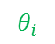
Fiber Generation
ˆ
ply
ply boundary
N
j
yarn boundary
$$θ_{i}$$
c
i
ply
c
j
R
yarn
ˆ
N
ˆ
B
ply
j
ˆ
B
yarn
yarn
c
Store as 1D texture
Notes:
We can do the same thing to get the fiber center as well. Note that yarn cross-section is a circle but the ply cross-section can be a ellipse.
[]
R and theta i here are precomputed based on the fiber distribution function and send to gpu as 1D texture. All others are predefined parameter. user can change interactively.

Slide 16
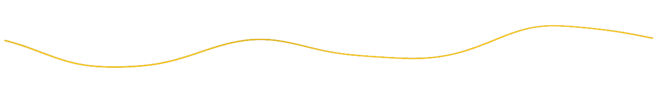
Fiber Generation
ˆ
ply
ply boundary
N
j
yarn boundary
c
i
ply
c
j
yarn
ˆ
N
ˆ
B
ply
j
ˆ
B
yarn
yarn
c
Notes:
After connecting all the fiber center, we can get the fiber curve.

Slide 17
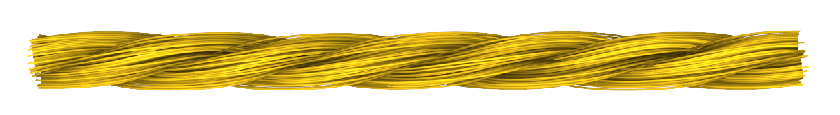
Fiber Generation
ply boundary
yarn boundary
fiber boundary
Notes:
And when we generate multiple fiber curve, we get the yarn finally. We also want to add some irregularities to the yarn.

Slide 18
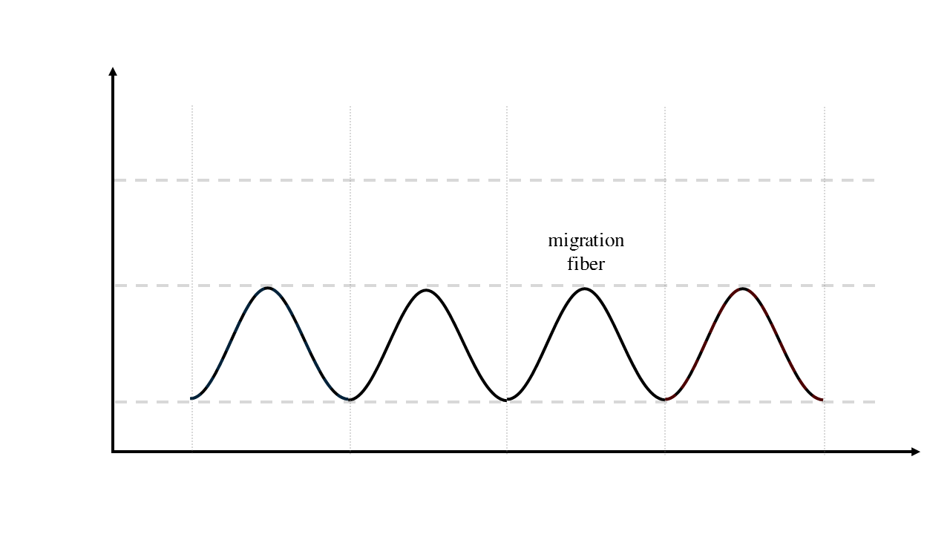
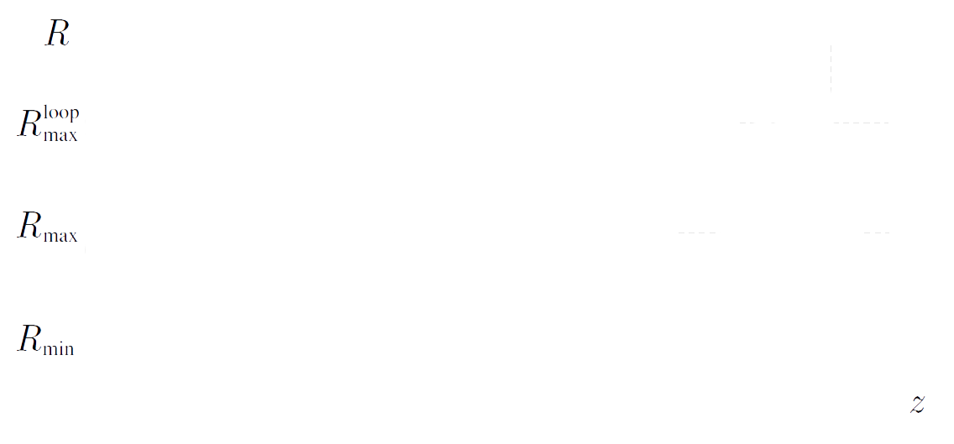
Fiber Types
Migration fiber
Notes:
Same as zhao’s paper, We first change the radius of fiber to yarn center periodly, which are called migration fibers.

Slide 19
Fiber Types
Migration fiber
Notes:
Same as zhao’s paper, We first change the radius of fiber to yarn center periodly, which are called migration fibers.

Slide 20
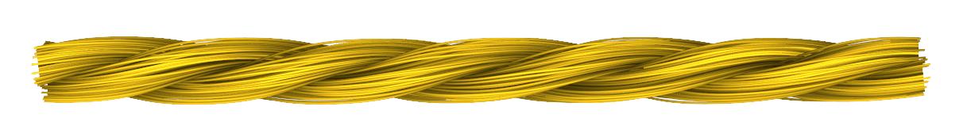
Fiber Types
Migration fiber
Notes:
Same as zhao’s paper, We first change the radius of fiber to yarn center periodly, which are called migration fibers.

Slide 21
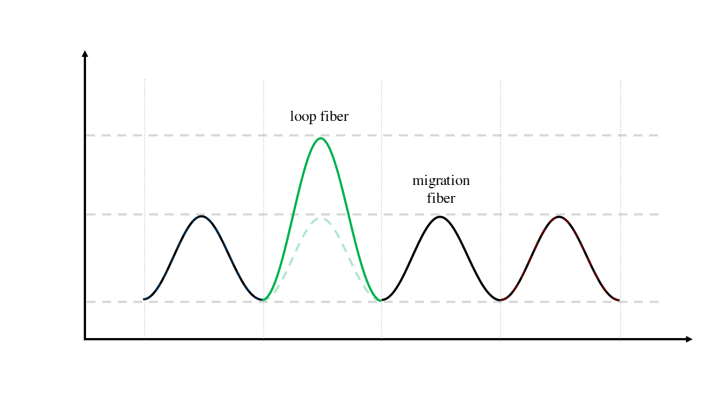
Fiber Types
Migration fiber
Loop fiber
Notes:
Then, We enlarge the radius of fiber in some period to make some loop fibers, which caused by the part of yarn has been accidentally pulled out during the manufacturing process

Slide 22
Fiber Types
Migration fiber
Loop fiber
Notes:
Then, We enlarge the radius of fiber in some period to make some loop fibers, which caused by the part of yarn has been accidentally pulled out during the manufacturing process

Slide 23
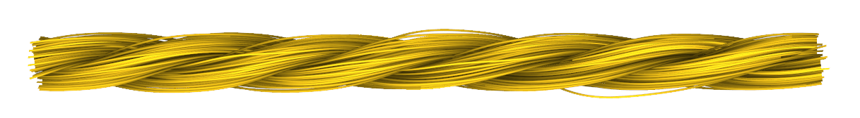
Fiber Types
Migration fiber
Loop fiber
Notes:
Then, We enlarge the radius of fiber in some period to make some loop fibers, which caused by the part of yarn has been accidentally pulled out during the manufacturing process

Slide 24
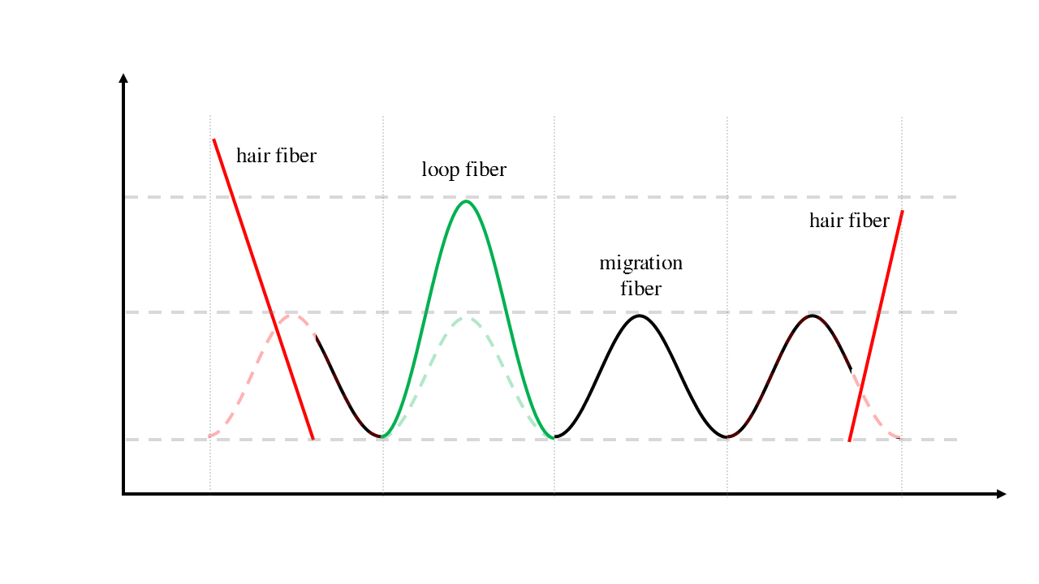
Fiber Types
Migration fiber
Loop fiber
Hair fiber
Notes:
Finally, different with zhao’s paper, we break some fibers and use that for hair fiber which are most important for the fuzzy appearance. The benefit is we don’t have add extra fiber curve for hair fiber, which is not very suitable for procedural model.

Slide 25
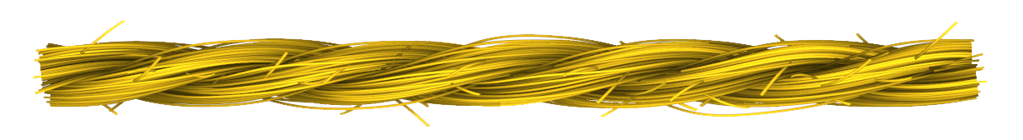
Fiber Types
Migration fiber
Loop fiber
Hair fiber
Notes:
Finally, different with zhao’s paper, we break some fibers and use that for hair fiber which are most important for the fuzzy appearance. The benefit is we don’t have add extra fiber curve for hair fiber, which is not very suitable for procedural model.

Slide 26
Overview
Modified Procedural
Yarn Model
Core Fibers
LoD
Self-shadows
Ambient Occlusion

Slide 27
Core Fibers
Hundreds of fibers per yarn
3 plies and 111~225 fibers in total
Expensive
Tessellation can only generate 64 isolines
Most fibers inside ply are invisible
Notes:
Now we have yarn with fibers. However, we notice that most fibers inside the ply actually are invisible or contribute less to the finally appearance. At the meantime, there are hundreds of fibers per yarn, but tessellation shader can only generate 64 isolines.

Slide 28
Core Fibers
Hundreds of fibers per yarn
3 plies and 111~225 fibers in total
Expensive
Tessellation can only generate 64 isolines
Most fibers inside ply are invisible
Core fiber
Single thick fiber represents all fibers near the center of the ply
Notes:
Now we have yarn with fibers. However, we notice that most fibers inside the ply actually are invisible or contribute less to the finally appearance. At the meantime, there are hundreds of fibers per yarn, but tessellation shader can only generate 64 isolines.

Slide 29
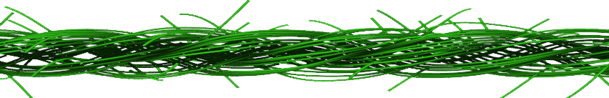
Core Fibers
Core fibers
Regular fibers

Slide 30
Core Fibers
Pre-render one full twist of all individual fibers that correspond to the core fiber to core texture
The height channel of an example core fiber texture
Notes:
To make the core fiber look realistic, we first pre-render all the individual fibers that correspond to the core fiber to the core fiber texture
[click]
Here is one example of core fiber texture

Slide 31
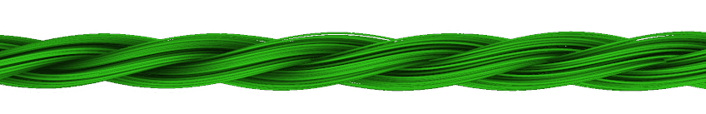
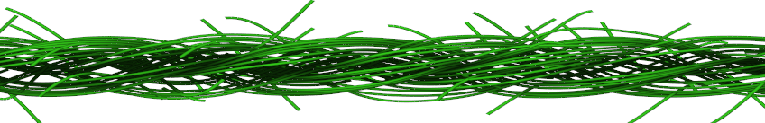

Core Fibers
Pre-render one full twist of all individual fibers that correspond to the core fiber to core texture
Core fiber texture mapping at run-time
The height channel of an example core fiber texture
Notes:
And do the texture mapping at run-time as the figure shown. The three tubes with core texture represent fibers inside ply
[click]
Now we have core fiber and regular fiber

Slide 32
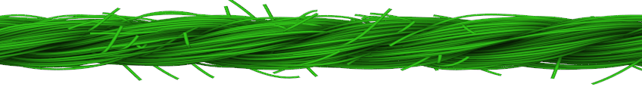
Core Fibers
Core fibers
Regular fibers
Core + Regular
Notes:
Combine them with regular fibers, we get our final yarns.

Slide 33
Core Fibers
Core fibers
Regular fibers
Core + Regular
Reference
[Zhao et al. 2016]
Notes:
Comparing with the reference, the fibers of which are generated offline, there is no difference visually.

Slide 34
Overview
Modified Procedural
Yarn Model
Core Fibers
LoD
Self-shadows
Ambient Occlusion

Slide 35


Level-of-detail (LoD)
Use the screen-space width of a fiber to control LoD
number of fibers per yarn
number of subdivisions along each
fiber curve
Yarn segments outside the view are discarded
Fiber #
No LoD
LoD
No LoD
LoD
Notes:
Since we are generating fibers on the gpu, we can use level-of-details strategy to minimize the number of fibers generated when the cloth is far from the view points.
[click]
To be more specific, we use the screen-space width of a fiber to control LOD.
Beside number of fibers per yarn, we also control the number of subdivision along fiber curve. Of course, more subdivision will produce smoother curves.
[click]
We also check if the yarn is out of the view frustum, we will discard yarn simply.
[click]
Here is the one example of with and without level-of-detailed. The number of fiber per yarn is visualized by color.

Slide 36
Overview
Modified Procedural
Yarn Model
Core Fibers
LoD
Self-shadows
Ambient Occlusion

Slide 37
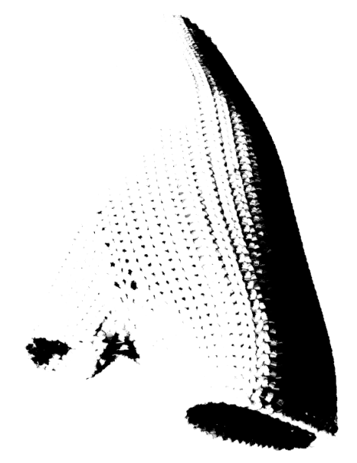
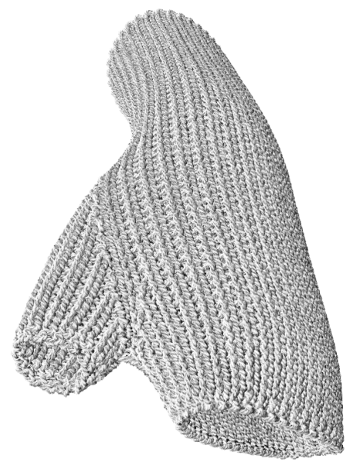
Self-shadows
Yarn-level self-shadows
Shadow map by rendering each yarn as thick tube
Fiber-level self-shadows
Precompute self-shadow density on the 2D cross-section plane of the yarn
Notes:
Self-shadows are extremely important for realistic fabric appearance. On the other hand, it is expensive to compute the fiber-level shadows of a yarn model. In particular, using shadow maps for individual fiber shadows would require an extremely high-resolution shadow map, since individual fibers are typically orders of magnitude thinner than the size of the cloth model.
[click]
Therefore, we separate self shadow into yarn level shadow and fiber level shadow.
[click]
For the yarn level shadow, we just generate a shadow map by rendering each yarn as thick tube.
[click]
For the fiber level shadow, we precompute self-shadow density on the 2D cross section plane of the yarn based on the fiber distribution density.
Here is the example.

Slide 38
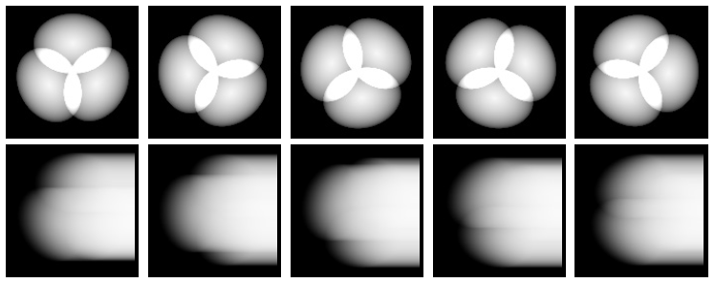
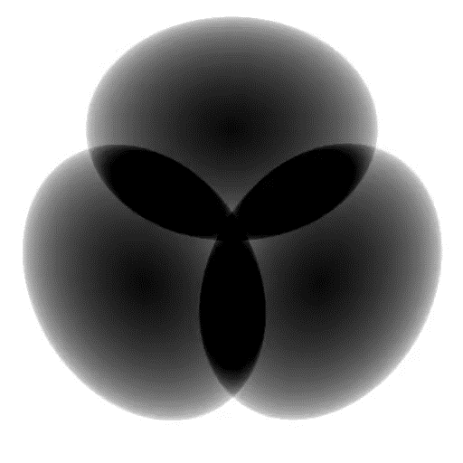

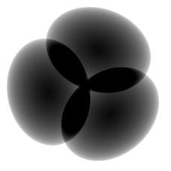
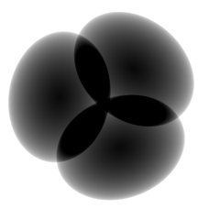
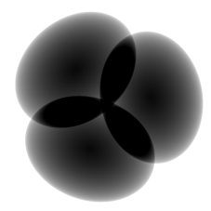
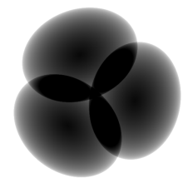
Self-shadows
Fiber density
Light direction
`
Self-shadow density

Slide 39

Self-shadows
Light direction
Light direction
c
i
c
i
Light direction

Slide 40
Overview
Modified Procedural
Yarn Model
Core Fibers
LoD
Self-shadows
Ambient Occlusion

Slide 41
Ambient Occlusion
Use the distance from fiber center to yarn center to linearly scale the ambient light
Notes:
ambient occlusion can substantially improve the image quality, but it can also have a considerable computation cost.
[click]We use a very simple ambient occlusion approximation that uses the distance from fiber center to the yarn center to linearly scale the ambient light.
[click]here is one example

Slide 42
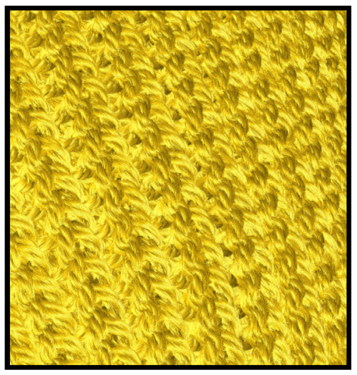
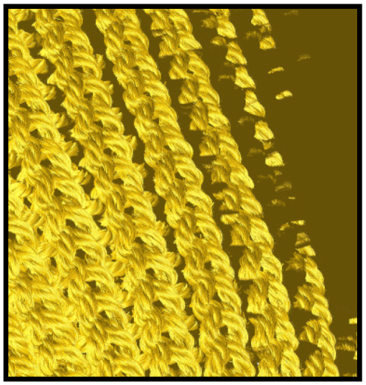
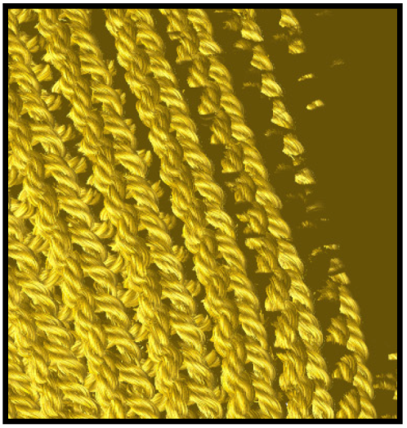
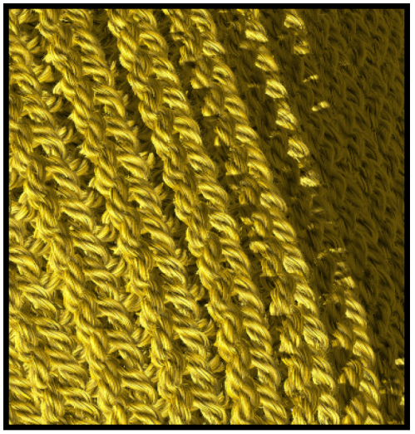
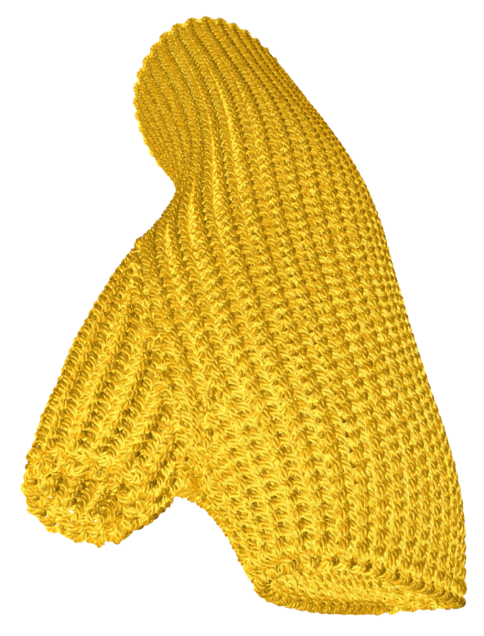
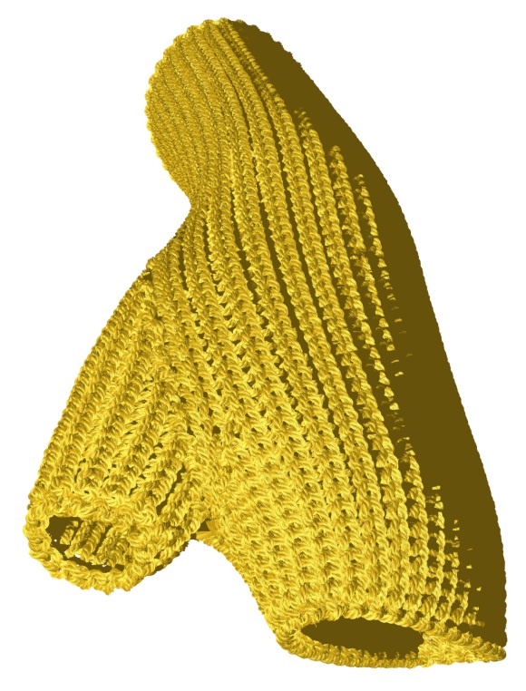


Example
No Shadow
+ Shadow Map
+ Self-shadows
+ Ambient Occlusion
Notes:
Here is one example of knitted glove without shadow and ambient occlusion.
[click]
After adding shadow map, it looks realistic, but missing some details
[click]
After adding self-shadow, it looks better specially for the yarn details.
[click]
Finally, we add the ambient occlusion, it looks much better note the details under shadow.

Slide 43
Results

Slide 44
Results

Slide 45



Results
Ours
Cotton 2
Reference
[Zhao et al. 2016]
Ours
Silk 1
Reference
[Zhao et al. 2016]
Ours
Silk 2
Reference
[Zhao et al. 2016]
Notes:
Here are more example of our result comparing with offline generated reference with different materials. Like cotton and silk. There is no visually difference between our result and reference.

Slide 46






Results
Notes:
Here is the frames per second performance values on camera distance for all examples. The fps is from 2 ms to 28 ms based on model size and camera distance.

Slide 47



Results
Far view
7 ms
Middle view
25 ms
Close view
17 ms
Notes:
Here is the frames per second performance values on camera distance for all examples. The fps is from 2 ms to 28 ms based on model size and camera distance.

Slide 48







Results
Rendering time per frame
Notes:
Here is the frames per second performance values on camera distance for all examples. The fps is from 2 ms to 28 ms based on model size and camera distance.

Slide 49
Results
Rendering time per frame
Notes:
When the camera is too close to the model, part of model will be discard since it is out of view frustum, so we can get high performance too,

Slide 50
Results
Rendering time per frame
Notes:
When the model is far away from the view, number of fibers and number of subdivision is reduced to increase the fps

Slide 51
Results
Rendering time per frame
Notes:
The interesting part is when camera is in the middle distance, which means no yarn curve are discard and they need to be rendered with high number of fibers, this cause a bottleneck for the performance. Even in this worst case, the fps still be around 25 frame per second.

Slide 52
Live Demo

Slide 53
Live Demo

Slide 54
Conclusion

Slide 55
Conclusion

Slide 56
Conclusion
Modified Procedural
Yarn Model
Core Fibers
LoD
Self-shadows
Ambient Occlusion

Slide 57
Conclusion
Notes:
Here is the frames per second performance values on camera distance for all examples. The fps is from 2 ms to 28 ms based on model size and camera distance.

Slide 58
Real-time Fiber-level Cloth Rendering
Kui Wu & Cem Yuksel
University of Utah
kwu@cs.utah.edu

